Slide 1
Creativity & Innovation
BM006-3-2-CRI (VC1) 1st April 2018
Lecture 8:
Entrepreneurial marketing

Slide 2
Topic Learning Outcomes
To demonstrate qualities and transferable skills necessary for entrepreneurial marketing:
  Definition of market
  The importance of marketing
  Unique selling proposition

Slide 3
BRCK
http://www.ted.com/playlists/2/tech_breakthrough

Slide 4
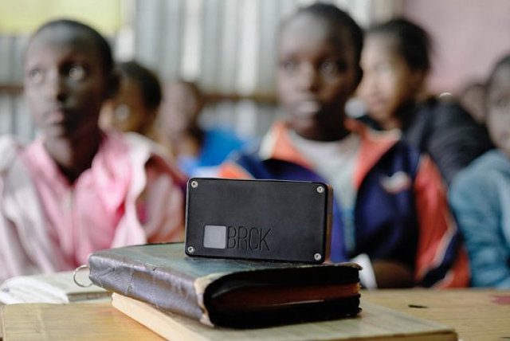

Made In Kenya, Assembled In America: This Internet-Anywhere Company Innovates From Silicon Savannah
Ushahidi originally billed BRCK as a "backup generator for the Internet," though their messaging has evolved into "The go anywhere, do anything, self-powered, mobile Wi-Fi device." It is essentially a mobile Internet router. It connects to the web in three ways: by plugging in a standard ethernet cable, by bridging with other Wi-Fi networks, or by accessing 3G or 4G data via a basic SIM card.
Ushahidi invented it in order to overcome infrastructure challenges—specifically, inconsistent electricity and Internet connectivity—plaguing young upstarts in Nairobi. Turns out, plenty of other people and places face the same challenges; the first run of BRCKs are being delivered this month to users in some 45 countries.
http://www.fastcoexist.com/3035137/change-generation/made-in-kenya-assembled-in-america-this-amazing-internet-anywhere-router-c

Slide 5
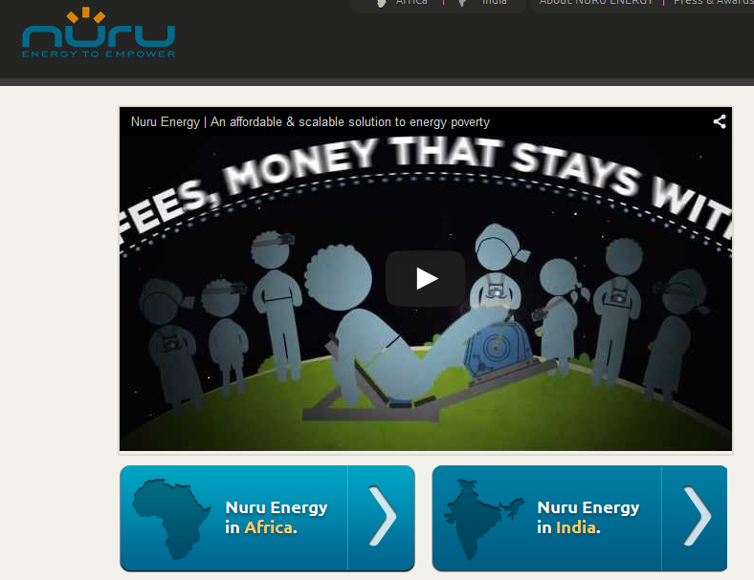

Slide 6
Two billion people in the world do not have access to electricity. At the same time, recent market based analysis shows that this represents a proven cash-based market.
According to a recent IFC energy access report (International Finance Corporation) , poor households spend a total of $37 billion/year (10-40% of their income) on kerosene and other low-quality energy solutions.
In addition to its high cost, kerosene poses serious fire and health hazards (two million people a year die from indoor pollution, more than from than malaria) and it releases millions of tons of carbon dioxide each year.
Alternative technologies, such as solar, are healthier and offer greater value, yet they require one-time investments of around $10-25, which are not affordable for people living on $1-2 a day.

Slide 7
To help these people to get off kerosene, IFC have been working with Nuru Energy, a for profit social enterprise working in Rwanda, where 85% of the population lacks access to the energy grid.
Nuru is dedicated to “replacing the use of expensive, unhealthy and dangerous kerosene as a source of lighting for the two billion people without access to electricity”.
Seed funded by the World Bank, Nuru offers ultra-affordable portable LED light solutions through an innovative micro-payment business model. The company is currently offering the most popular off-grid lighting product in Rwanda, already accounting for 45% of monthly sales by volume in 2012.
https://hbr.org/2014/12/a-lean-startup-approach-to-international-development

Slide 8
Definitions: Marketing ...
… is the management process responsible for identifying, anticipating and satisfying customer requirements profitably. (UK)
… is the discipline of conceiving offers
as a function of consumer preferences,
and promoting their commercialization. (France)
…is market-oriented management. (Germany)
Entrepreneurial Marketing Strategy

Slide 9
1.2) Individual Qualities
Comparison
The Entrepreneur… | The Marketer…
…is creative, innovative, open for the unconventional | …tries constantly to stay abreast of competitors
…is ready to take risks, deal with uncertainty | …creates or seizes market opportunities
…works for sustainable business growth | …works to increase market share or build better customer relationships
Entrepreneurial Marketing Strategy

Slide 10
1.3) Entrepreneurial Marketing: Strategic Challenges
exceed customer expectations
build trust, keep promises
Customers
Internal
Com-
petitors
manage processes
show leadership
seize opportunities
change the rules
balance attack,
defence and evasion
Entrepreneurial Marketing Strategy

Slide 11
2.1) Defining the Offer:
The Ansoff Matrix
Markets
existing
new
Market
existing
Penetration
Development
Products
Product
new
Diversification
Development
Entrepreneurial Marketing Strategy

Slide 12






2.2) Defining the Offer:
The Basis For Differentiation
 | Product | Price | Promotion | Place
Where is their basis
for differentiation ?
Entrepreneurial Marketing Strategy

Slide 13
2.3) “What’s In It For Me?”
Customer Benefit Definition
product feature | generic benefit | meaning to customer
extended opening hours | convenience | freedom
customer loyalty card | savings | feeling market savvy
eco-certified products | good conscience | leading a meaningful life
Entrepreneurial Marketing Strategy

Slide 14
2.4) USP — Formulate a Unique Selling Proposition
"When it absolutely, positively
has to be there overnight" – FedEx
"Connecting people" – Nokia
"Because I'm worth it" - L'Oreal
(“Parce que je le vaux bien”)
“United Colors of Benetton”
Entrepreneurial Marketing Strategy

Slide 15
3) Defining the Market
– Marketing Style
Transactional Marketing | Relationship Marketing
“make-and-sell” | “sense-and-respond”
sales volume maximization | customer value maximization
branding, advertising, distribution partners | personal selling, direct and database marketing
packaged goods | individual services
one-time customer | lifetime customer
high market share | stable relationships
Entrepreneurial Marketing Strategy

Slide 16
3) Defining the Market
– Customer Profiling
Transactional Marketing:
Who is
your typical customer?
Build a demographic portrait:
Age bracket, cohort
Family life cycle stage
Education, occupation
Disposable income/month
Usage pattern ...
Relational Marketing:
How does
your typical customer
interact with you?
Build a customer life cycle:
Non-customer
Prospect, lead
First timer
Repeat buyer
Testimonial
Entrepreneurial Marketing Strategy

Slide 17
Timing the Entry Into the Market
— First Move Considerations
First Mover Advantages
Primacy effect: Making an early and lasting effect on customers
Investments into the market (e.g.: distribution network, consumer awareness) will pay off early.
First mover can start to build experience early, increase the lead and solidify the strategic position
First Mover Disadvantages
Recency effect: Followers have benefit of newness
Competitors’ free rider effect; investments may turn out to be exit barriers if/when market declines
Competitors may catch up or outperform first mover if imitation barriers are low
Entrepreneurial Marketing Strategy

Slide 18


Conclusion: The Innovation Cartwheel
Entrepreneurial
Marketing Strategy
– a constant interplay
of rulebreaking and
mainstreaming ...
Harvest Profit
Potential
Economies
of Scale
Finding New Ideas
Innovation
Creativity
Positioning
against
Competitors
Differentiation
Marketing
New Ideas
Making them
acceptable to customers
Entrepreneurial Marketing Strategy

Slide 19
Question and answer session
Q & A
Slide <<number>> of 13

Slide 20
What we will cover next
Intellectual property
Slide <<number>> of 13

Slide 21
https://www.techinasia.com/break-indonesias-crowded-mobile-messaging-market/

Slide 22
https://hbr.org/2015/07/engineering-reverse-innovations

Slide 23
Billion dollar start-up club
https://500.co/startups/
http://graphics.wsj.com/billion-dollar-club/

Slide 24
Activity
Based on the companies in ‘billion dollar start-up club’;
Justify the unique selling points of the company
Identify the customer profile
Market identification – Price, Place, Promotion, Package

